Slide 1
Alzheimer’s Disease Research Center (ADRC) New Site Training

Slide 2

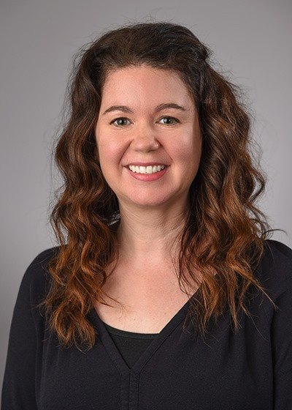
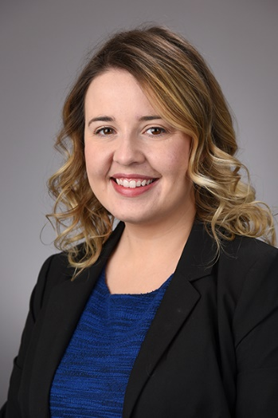
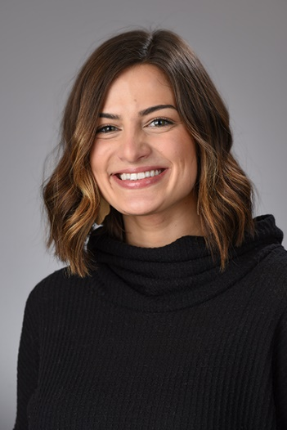
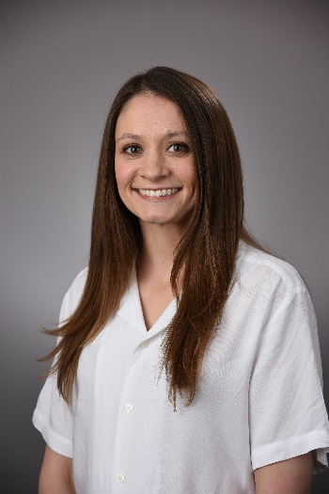
NCRAD ADRC Staff
Tatiana Foroud, PhD
Principal Investigator of NCRAD
Kelley Faber, MS, CCRC
Project Manager of NCRAD
Kaci Lacy, MPH, CCRP
Clinical Research Coordinator
Zoë Potter, BA
Clinical Research Specialist
Jillian Ryan, BA,BS
Clinical Research Specialist

Slide 3
Training Overview
Kit Requests Module
Sample Collection and Processing
Sample Shipping
Review and Questions

Slide 4
Kit Request Module Brain Tissue, Buffy Coat, and Transferred DNA Supplies
www.kits.iu.edu/adc

Slide 5
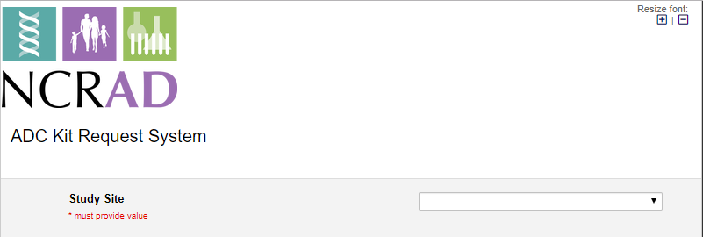
ADC Kit Request Module
Choose your site from the drop-down list.

Slide 6
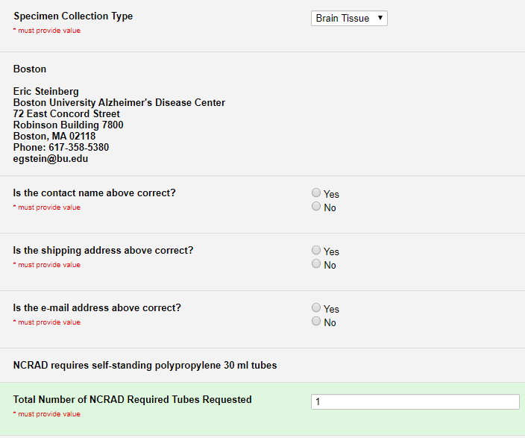
ADC Brain Tissue Supplies
The coordinator name and contact information will appear.
Verify that this information is accurate, or correct it if necessary.
If contact information is unknown or incorrect, please check “No” and provide new information in free text fields that will appear.
Enter number of tubes needed

Slide 7
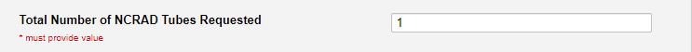
ADC Buffy Coat Supplies
Enter number of tubes needed

Slide 8
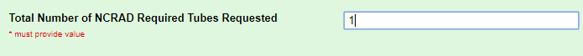
ADC Transferred DNA Supplies
Enter number of tubes needed

Slide 9
Handling/Processing Study Specimens

Slide 10
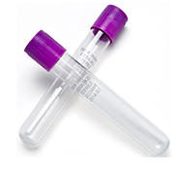
Blood
Blood Requirements
Can collect between 1-3 10ml EDTA
Can send samples to NCRAD either ambient or frozen
Ambient samples must be received within 5 days of collection

Slide 11
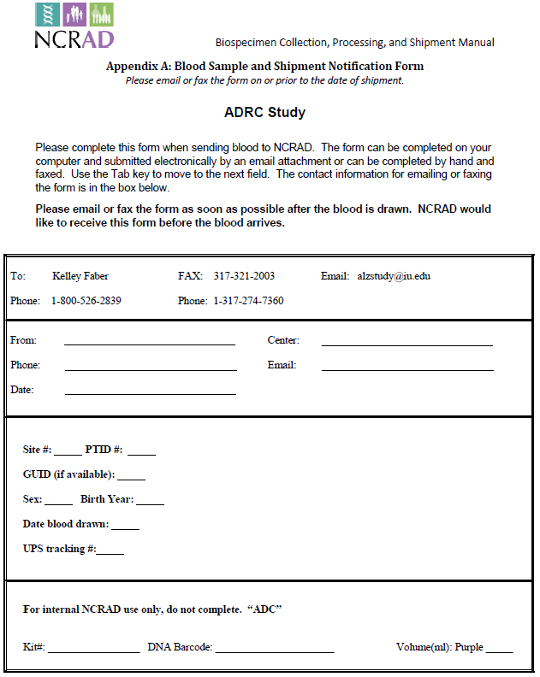
Blood Sample Form
Send by e-mail prior to shipment, and include a copy in each shipment

Slide 12
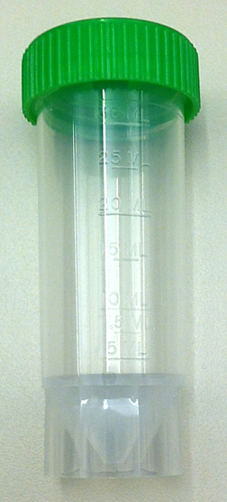
Brain Tissue
Brain Tissue Requirements
2-5 grams of tissue minimum
Grey matter maximized, preferably frontal cortex
Must be shipped within a self standing polypropylene 30 mL tube (pictured)
NCRAD will provide these tubes, if needed

Slide 13
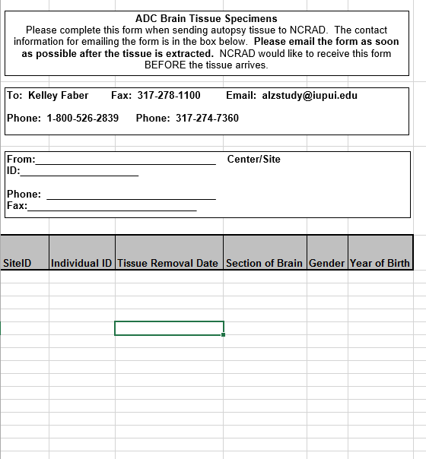
Brain Tissue Sample Form
Note: Individual ID=PTID
(ID submitted to NACC with UDS data)
Please organize samples within the shipment box in the same order as they are listed on the sample form.
Send by e-mail prior to shipment, and include a copy in each shipment

Slide 14
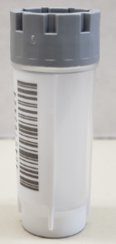
Buffy Coat
Buffy Coat Requirements
No volume requirements BUT we must receive the whole buffy coat
No required tubes
NCRAD will provide tubes, if needed: 2ml gray capped Micronic cryovials

Slide 15
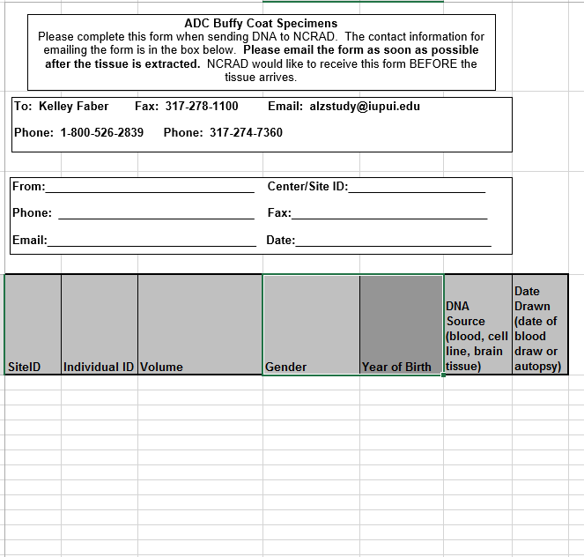
Buffy Coat Sample Form
Note: Individual ID=PTID
(ID submitted to NACC with UDS data)
Please organize samples within the shipment box in the same order as they are listed on the sample form.
Send by e-mail prior to shipment, and include a copy in each shipment

Slide 16
Transferred DNA
Transferred DNA Requirements
Specimen should be at least 20 ug
Minimum concentration of 0.1 ug/ul
Minimum volume of 50 ul
Note: do not send 50ul at 0.1ug/ul in total as that is not enough DNA. However, when sending 20ug, please do not use a concentration less than 0.1ug/ul and do not send a volume less than 50ul.
Must be shipped in 2ml gray capped Micronic cryovials
NCRAD will provide tubes, if needed

Slide 17
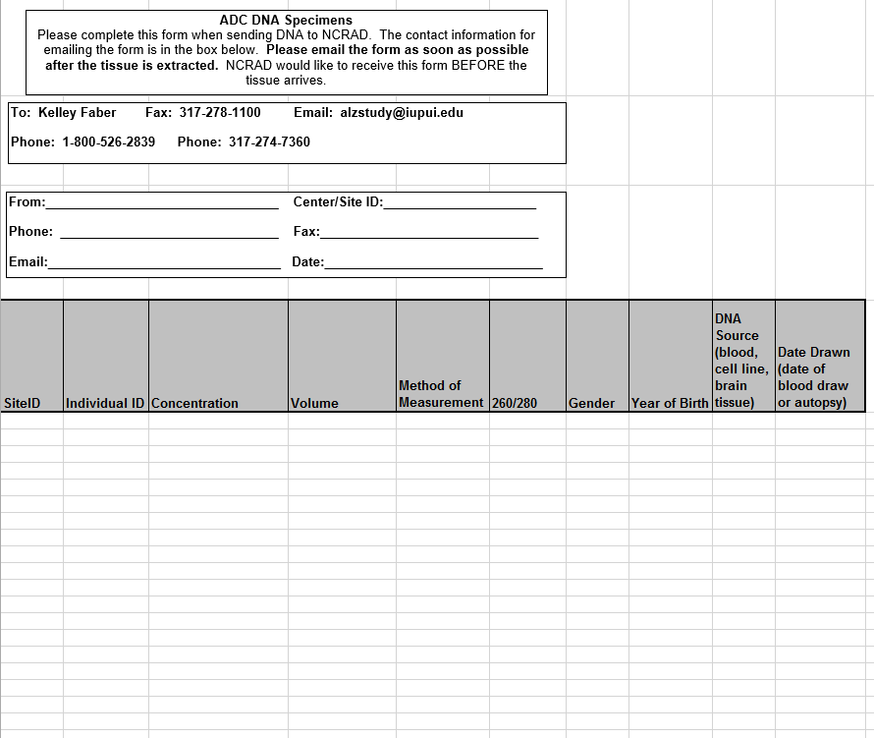
DNA Sample Form
Note: Individual ID=PTID
(ID submitted to NACC with UDS data)
Please organize samples within the shipment box in the same order as they are listed on the sample form.
Send by e-mail prior to shipment, and include a copy in each shipment

Slide 18
Sample Shipments

Slide 19
Ambient Samples
Only Monday-Thursday collection and same day shipping. Plan ahead to schedule UPS.
Whole blood samples must be received at NCRAD within 5 days of collection.
Do NOT draw or ship ambient samples on Friday!
Include copy of Blood Sample Shipment and Notification Form

Slide 20
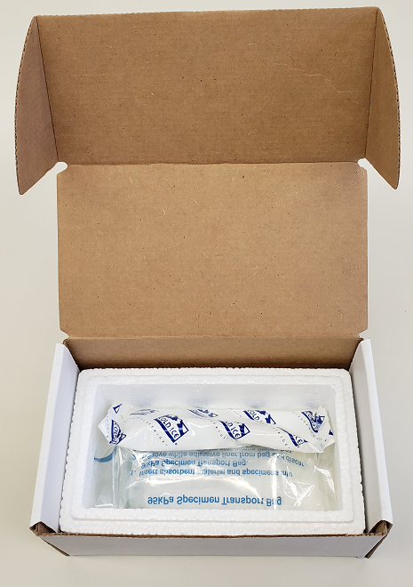
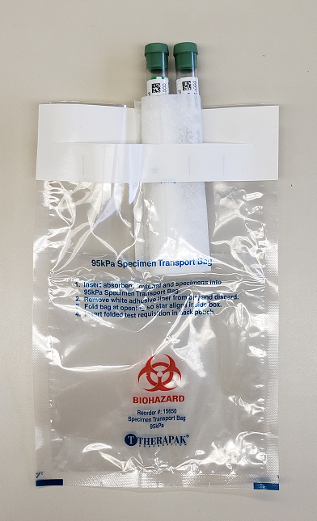
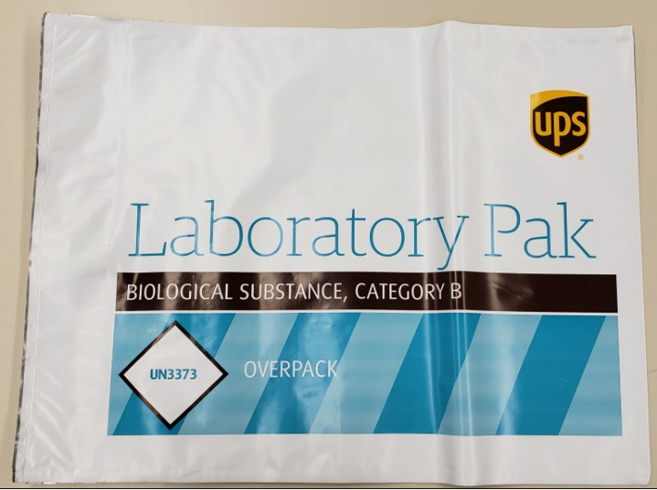
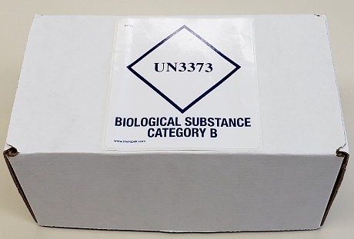
Ambient Shipment Packaging
Place the ambient tubes in the absorbent slots and biohazard bag.
Place the bag inside the small shipping box, and then set the refrigerant pack on top of it.
Place small shipping box within a provided UPS Laboratory Pak, seal, and place UPS label on outside of package.
*Gel packs must be put in a freezer at minimum the night before shipping.

Slide 21
Frozen Samples
Ship Monday-Wednesday Only
Hold packaged samples in a -80°C freezer until pickup.
Batch Samples together
Please organize samples within the shipment box in the same order as they are listed on the sample form.
Ensure that all samples are appropriately labeled
Use dry ice pellets
Do not use dry ice chunks: will crack the tubes and damage the specimens
Send Sample Form to IU ahead of shipment
Email: alzstudy@iu.edu

Slide 22
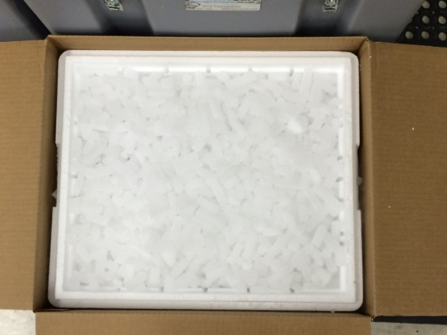
Frozen Shipment Packaging
Place 2-3 inches of dry ice in the bottom of the Styrofoam shipping container, then insert the cryoboxes laying upright.
Fully cover the cryoboxes with about 2 inches of dry ice in the provided shipper.

Slide 23
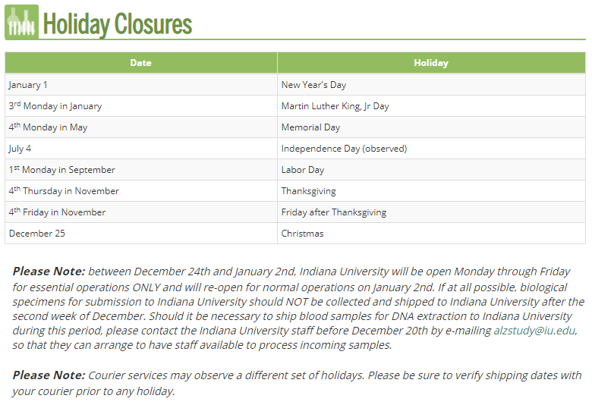
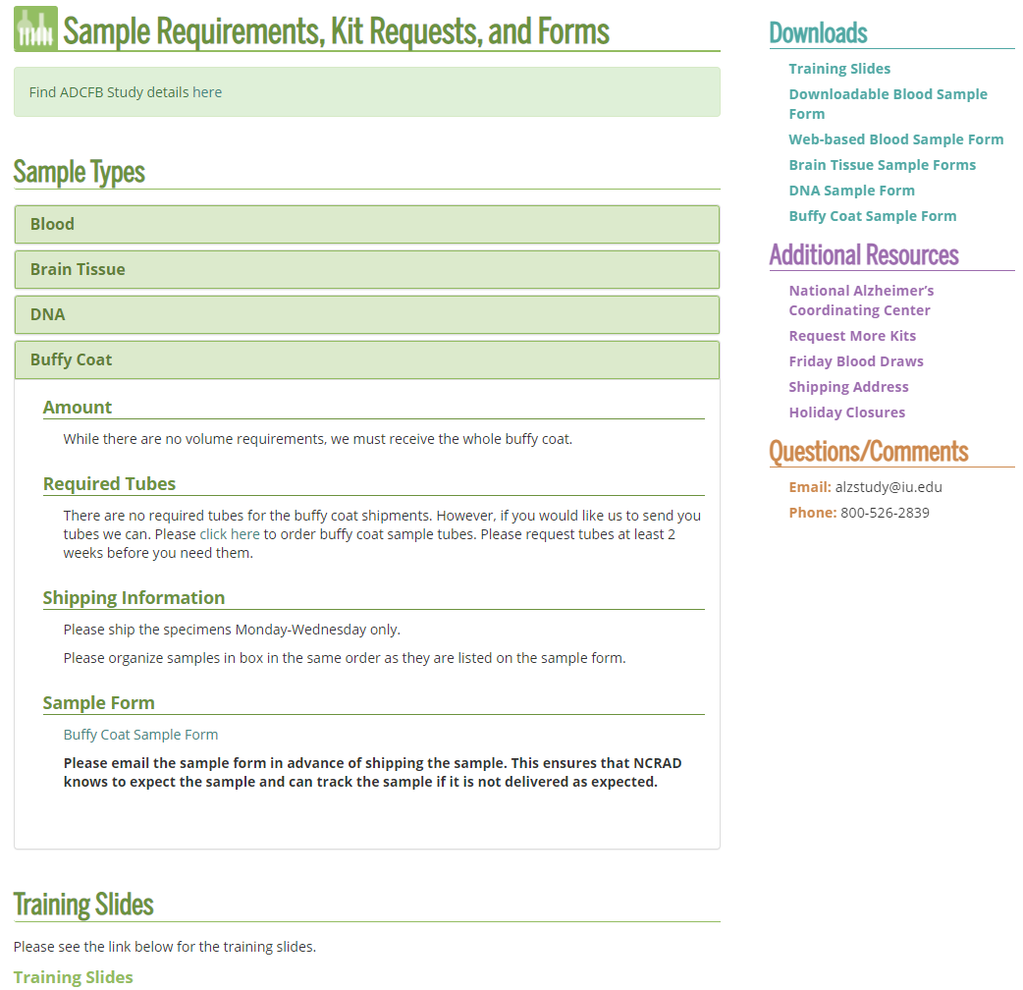
NCRAD Website: Helpful Pages
https://ncrad.org/holiday_closures.html https://ncrad.org/sample_requirements.html

Slide 24
Contact Information
Kaci Lacy
Phone: (317) 278-1170
E-mail: lacy@iu.edu
General NCRAD Contact
Phone: (800) 526-2839
E-mail: alzstudy@iu.edu
Website: www.ncrad.org

